Slide 1
Machine Vision: Understanding Deep Learning
Chapters 4 + 6
Multi-Layer Perceptrons &
Iterative Training
Notes:
http://colah.github.io/
http://www.deeplearningbook.org/
http://scs.ryerson.ca/~aharley/vis/conv/
http://cs231n.github.io/convolutional-networks/

Slide 2
Terminology
Activation
Pre-activation
(Pictured: Multi-layer Perceptron)
This work is subject to a Creative Commons CC-BY-NC-ND license. (C) MIT Press.

Slide 3
Shallow Network Example: 1 input
This work is subject to a Creative Commons CC-BY-NC-ND license. (C) MIT Press.

Slide 4
Shallow Network Example: 2 inputs

Slide 5
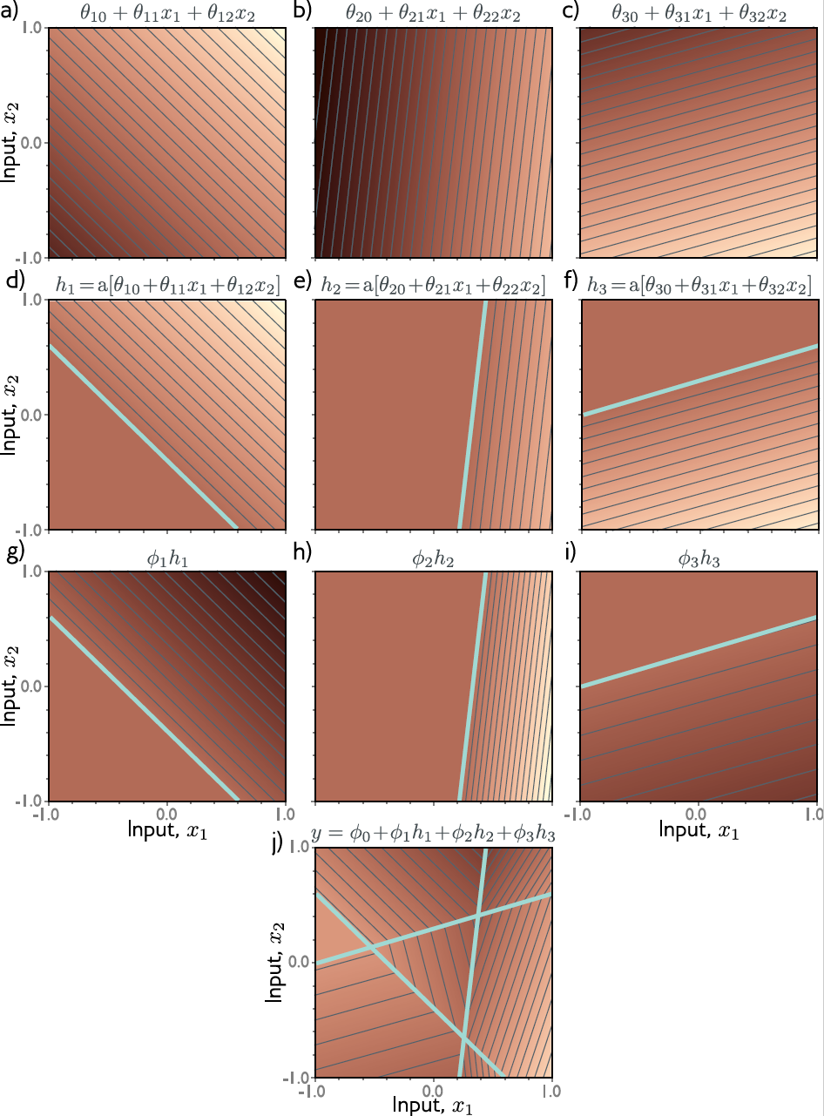
Shallow Network Example: 2 inputs
This work is subject to a Creative Commons CC-BY-NC-ND license. (C) MIT Press.

Slide 6
Deeper Network Example: 1 input
This work is subject to a Creative Commons CC-BY-NC-ND license. (C) MIT Press.

Slide 7
Deeper Network Example: 2 inputs
This work is subject to a Creative Commons CC-BY-NC-ND license. (C) MIT Press.

Slide 8
Weight Training(!)
This work is subject to a Creative Commons CC-BY-NC-ND license. (C) MIT Press.

Slide 9
Weight Training(!)
Step 1: Compute derivatives of Loss relative to each parameter
Step 2: Update parameters:
(indicates uphill direction of the loss function)
This work is subject to a Creative Commons CC-BY-NC-ND license. (C) MIT Press.

Slide 10
Training: Linear Regression Example
This work is subject to a Creative Commons CC-BY-NC-ND license. (C) MIT Press.

Slide 11
Training: Gabor Model Example

Slide 12
Training: Gabor Model Example
Samples from specific instance:

Slide 15
Improving on Gradient Descent
Stochastic Gradient Descent
Momentum
Normalized Gradients
Notes:
m: gradient
v: pointwise squared gradient

Slide 17
(so momentum AND normalized gradients)

